Slide 1

Community Engagement Data Collection Form
VAdata: Virginia’s Sexual and Domestic Violence Data Collection System

Slide 2
What is Community Engagement?
  Community engagement activities include: public awareness, organizational development or capacity building, development of knowledge, skills, and abilities or training, and community collaborations.

Slide 3
Information Collected on the Community Engagement Form
The Community Engagement Form is divided into 4 sections:
    Information about Activity/Event
    Information about Participants
    Materials Distributed and Media Coverage
    Evaluation/Outcomes/Outputs
When services are provided that have been funded by
V-STOP, advocates will need to complete the VSTOP supplement.

Slide 4

Information Required to Submit Form
Data required in order to submit form:
  Date of Event
  Staff Name
  Locality
  Primary Purpose of Activity
  Total Number of Participants
There are many data elements on this form, but these are the only required fields!

Slide 5
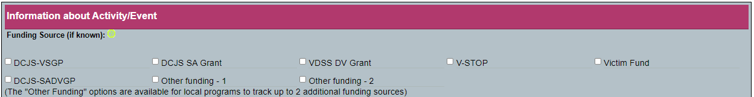
‘Information About Activity/Event’ Section
  Funding Source is OPTIONAL on this form. If a funding source is selected, then you will have the option to generate a report based on the activities funded by that particular source.
  NOTE: You will still be able to generate a report about ALL of your activities.
“Other Funding - 1” and “Other Funding - 2” can be used by agencies to track up to two additional funding sources that are relevant to their agency (for example, a United Way grant).
When VSTOP is selected as a funding source, a VSTOP supplemental tab will appear so you can collect more detailed data on training activities and generate a report for VSTOP (see slide 10 & 11).
As of 2019, the supplemental data is no longer required for recipients of Victim Fund grants.

Slide 6
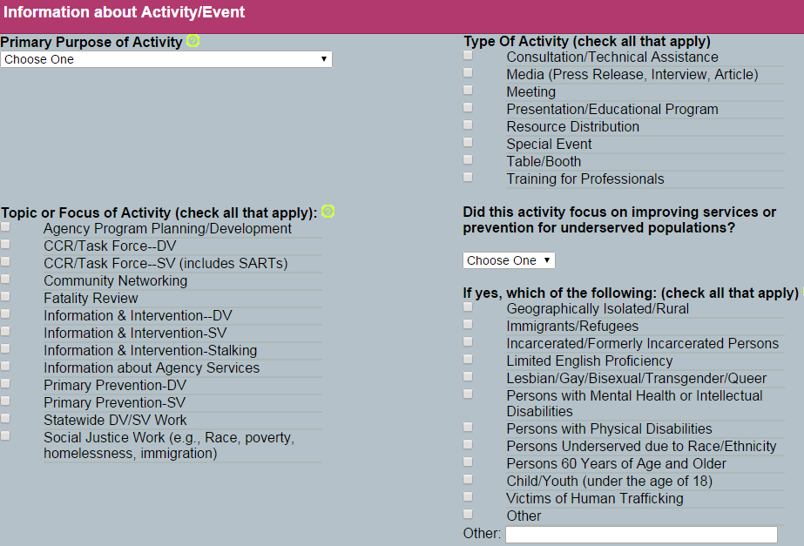
‘Information About Activity/Event’ Section
Primary Purpose of Activity – you will need to select ONLY ONE option that best fits the activity
Type of Activity – you can choose as many that apply.
  Note: The activity chosen will drive the section in the report in which the data will be included.
Topic or Focus of Activity – select all that apply
‘Did the activity focus on improving services or prevention activities for underserved populations?’ – please select YES if appropriate, and identify the population(s) addressed in your program or activity.

Slide 7
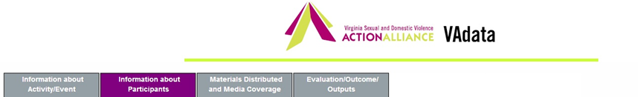
‘Information About Participants’ Section
In this section, Total Number of Participants is the most significant data element and is required to be completed.
Gender and Race/Ethnicity– will be most significant when the activity is related to “Presentations/Educational Programs”. Only include this information if it is known and collected directly from participants. Please do not assume this information.
Profession/Role of Participants – will be most significant when the activity is related to “Professional Training”.

Slide 8
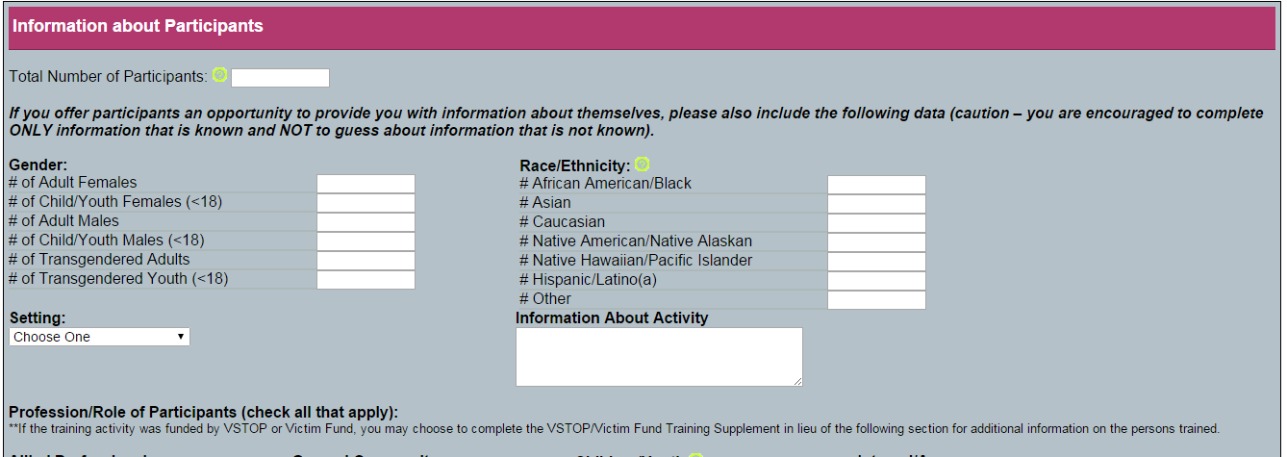
‘Information About Participants’ Section
In the Information About Activity text box, you may enter information your agency wishes to track. This field is not required, but you may want to enter information such as the title of the presentation or its specific location for internal tracking purposes.

Slide 9

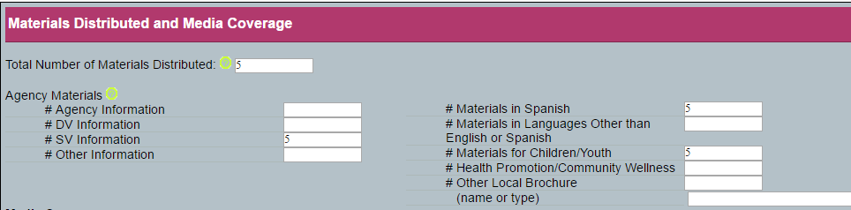
‘Materials Distributed and Media Coverage’ Section
Please include the total number of resources distributed. In the Breakdown section, you can list the same resources more than once if they are described in multiple categories.
For example, you might have a brochure about Sexual Violence that is for children and is written in Spanish. If you distributed FIVE of these brochures, you would enter “5” in the “Total Number of Materials Distributed” section, AND “5” in #SV Information, #Materials in Spanish, and #Materials for Children.

Slide 10
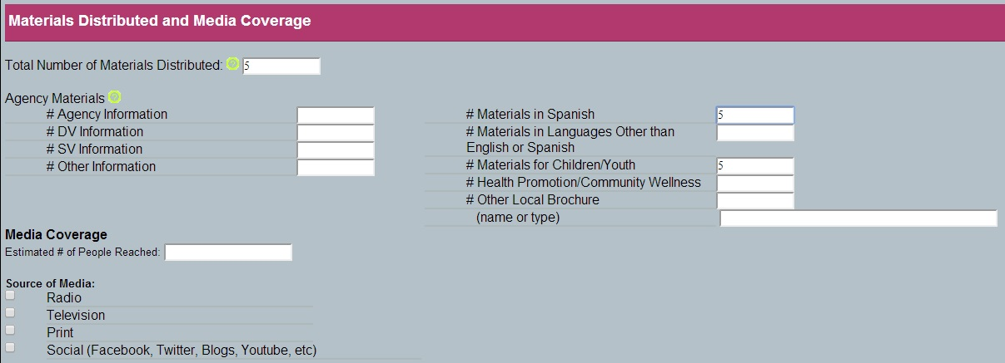
‘Materials Distributed and Media Coverage’ Section
The Media Coverage section covers radio, TV, print, and social media (Facebook, Twitter, blogs, etc).

Slide 11
‘Materials Distributed and Media Coverage’ Section
Some agencies wonder about a good time to track social media engagement on posts or comments.
Most social media platforms have internal analytics that will allow you to see views, likes, comments, and shares on your posts or images.
Generally, two weeks is a sufficient time to measure “engagement” on a particular post, but use your analytics to see when your social media accounts tends to be most active or have the most traffic and gauge when your follower are most active.

Slide 12

‘Evaluation/Outcomes/Outputs’ Section
The Training and Presentation/Education Outcomes are included as options. We hope that SDVAs report outcomes so we can preview the impact of sexual and domestic violence community engagement efforts across Virginia. Please include the questions listed here on your evaluations to help us see the statewide impact of your outreach.
Please note that in the Community Collaboration Outcomes section, we offer the opportunity to tell us about any new policies/protocols/resources that you have developed so that we can include them in our library as applicable. This is, of course, OPTIONAL.

Slide 13
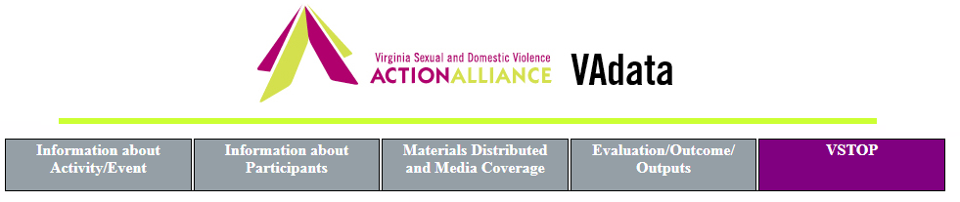
VSTOP Supplemental Information
VSTOP grantees are required to report additional information about people trained and the content of the trainings. Victim Fund grantees no longer need to complete this supplemental info.
If you do not receive VSTOP or Victim Fund grants for training activities, you can ignore this supplemental tab.

Slide 14
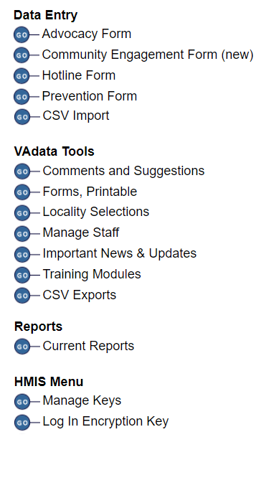
Community Engagement Report
Data from the Community Engagement form are compiled in the Community Engagement Report.
Community Engagement info is also included in your VDSS Domestic Violence Program Report and other reports as requested by funders.
Any VSTOP and/or Victim Fund training activities recorded on the Community Engagement Form will be compiled and included in your VSTOP and Victim Fund VAdata reports.
You will also be able to compile a report based on funding source.

Slide 15
Community Engagement Report
This report includes several sections:
  Summary (including a summary of activities by locality)
  Educational Programs Delivered (including info on participants by locality and summary of content)
  Professional Training Delivered (including breakdown by profession and content)
  Resources Distributed and Media Coverage
  Focus of Activities and a table of specific activities
This report also includes colorful graphs and charts!

Slide 16

Help Options
You may note this symbol by several fields on the form:
Click on the symbol for more detailed information or requirements of the field.

Slide 17
HELP! VAdata’s not working.
If you think something is wrong with VAdata, please let us know! Give us a call at 804.377.0335 OR email us at vadataadmin@vsdvalliance.org.
We don’t use VAdata in the same ways you do, so sometimes the only way that we know something is off or broken is when you tell us.
We also like to talk with you by phone when you have questions, because we usually want information that you might not know we need.

Slide 18
How Can I Get Additional Help About Other Topics or Concerns?
The Action Alliance staff urge you to contact us whenever you have a question or a concern about VAdata, resources, advocacy, policy, training, funding, or anything else.
Staff can be reached at
804.377.0335
Or you can visit our website to send a message directly to staff members. Visit https://vsdvalliance.org/contact/.

